Slide 1
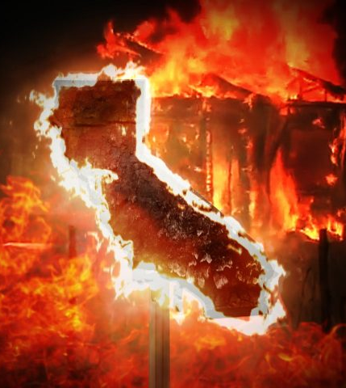
California Fire-quake
Bhavani Kumar
Carolyn Reyes
Kash Santos
Marianna Mangat
Ramin Jabbari
Wildfires and Earthquakes in California - 2010-2018

Slide 2
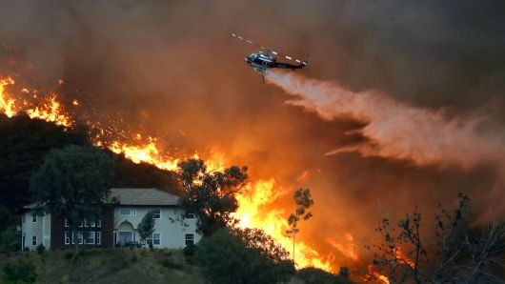
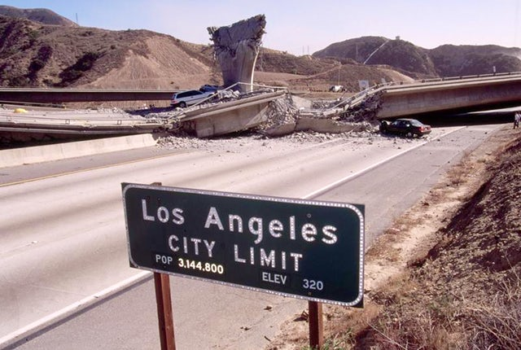
RECENT OBSERVATIONS ARE THEY CONNECTED?
WILDFIRES
EARTHQUAKES

Slide 3
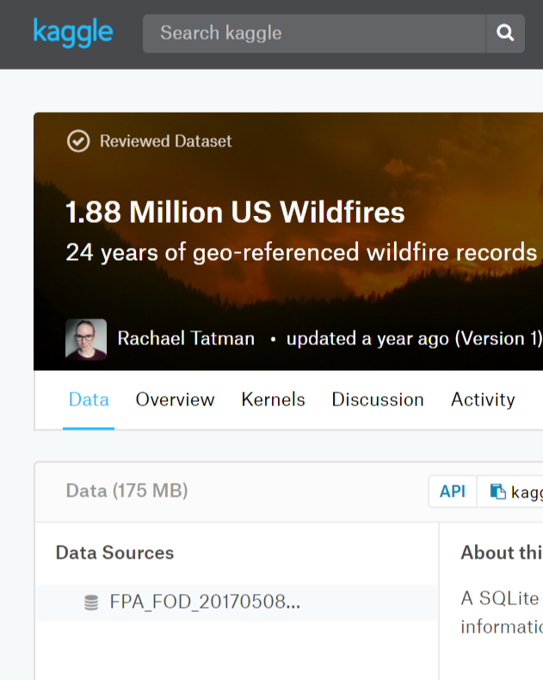
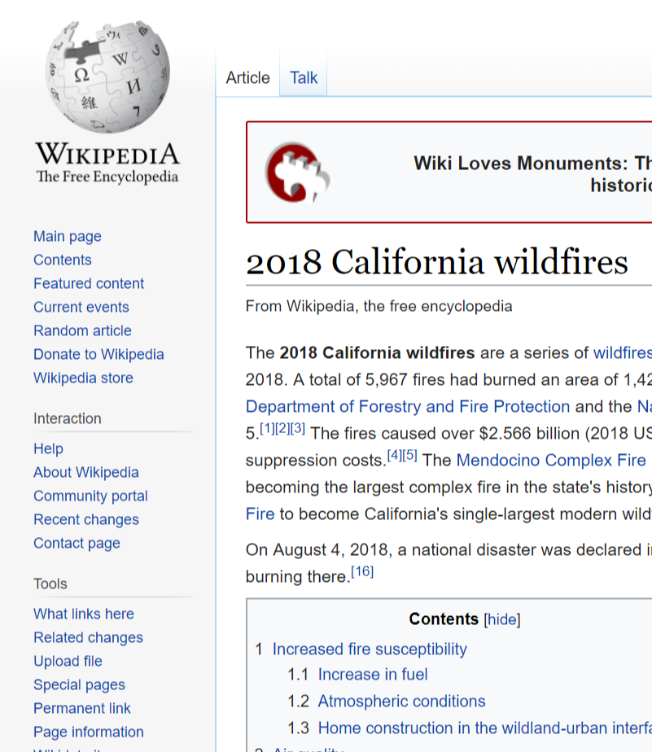
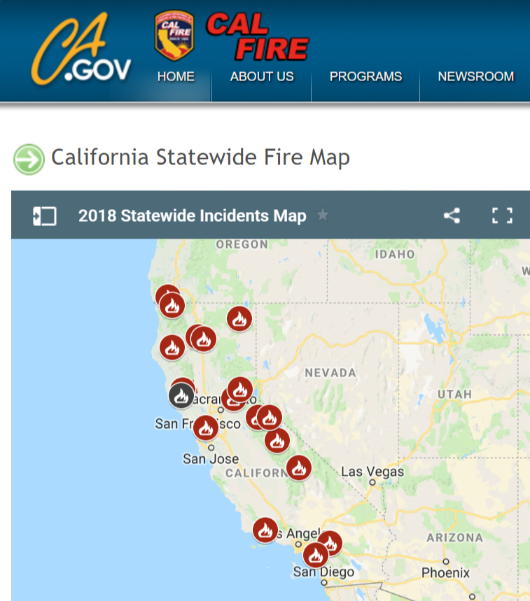
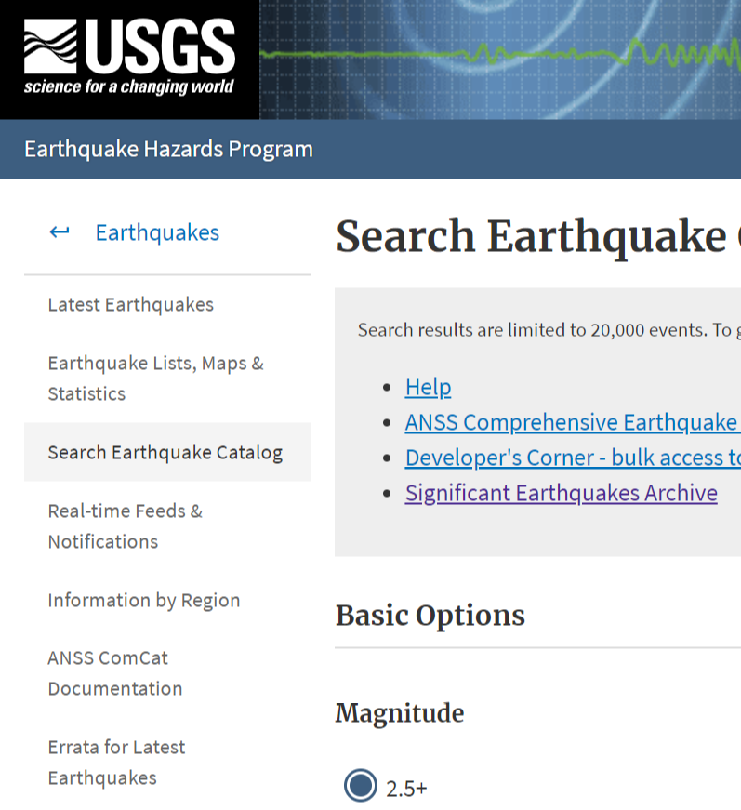
Data Research

Slide 4









DATA MUNGING

Slide 5
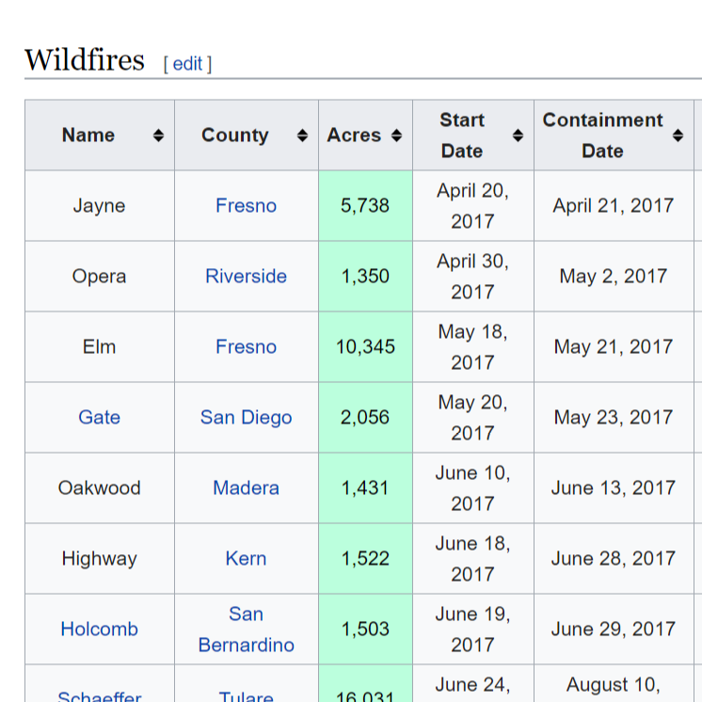
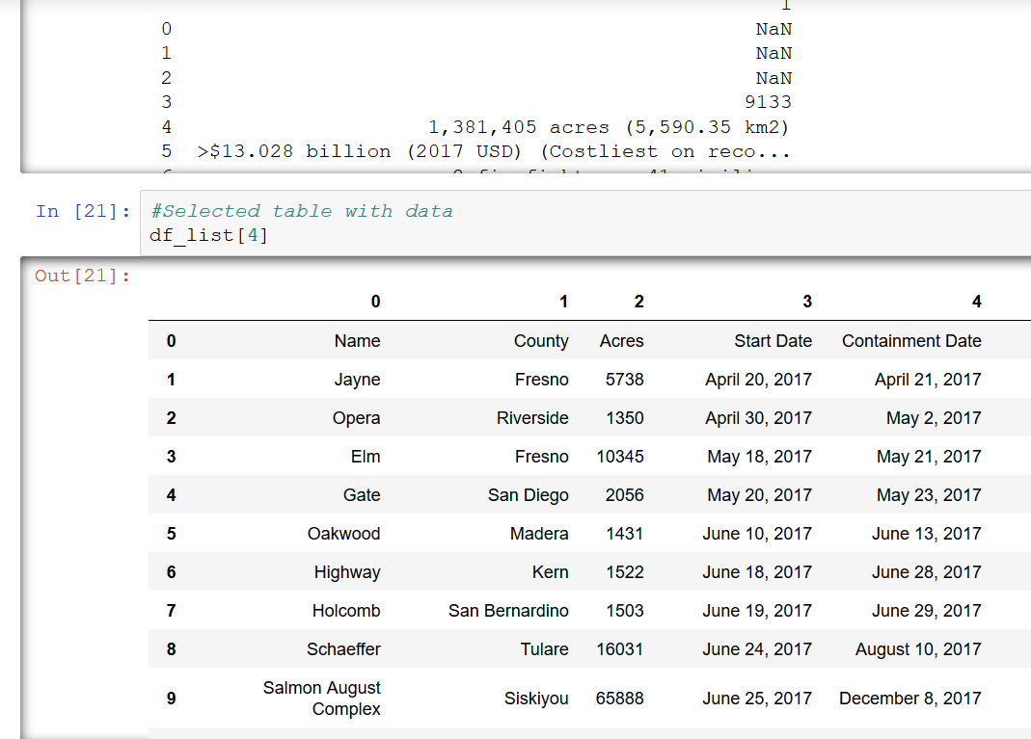
WEB SCRAPING

Slide 6
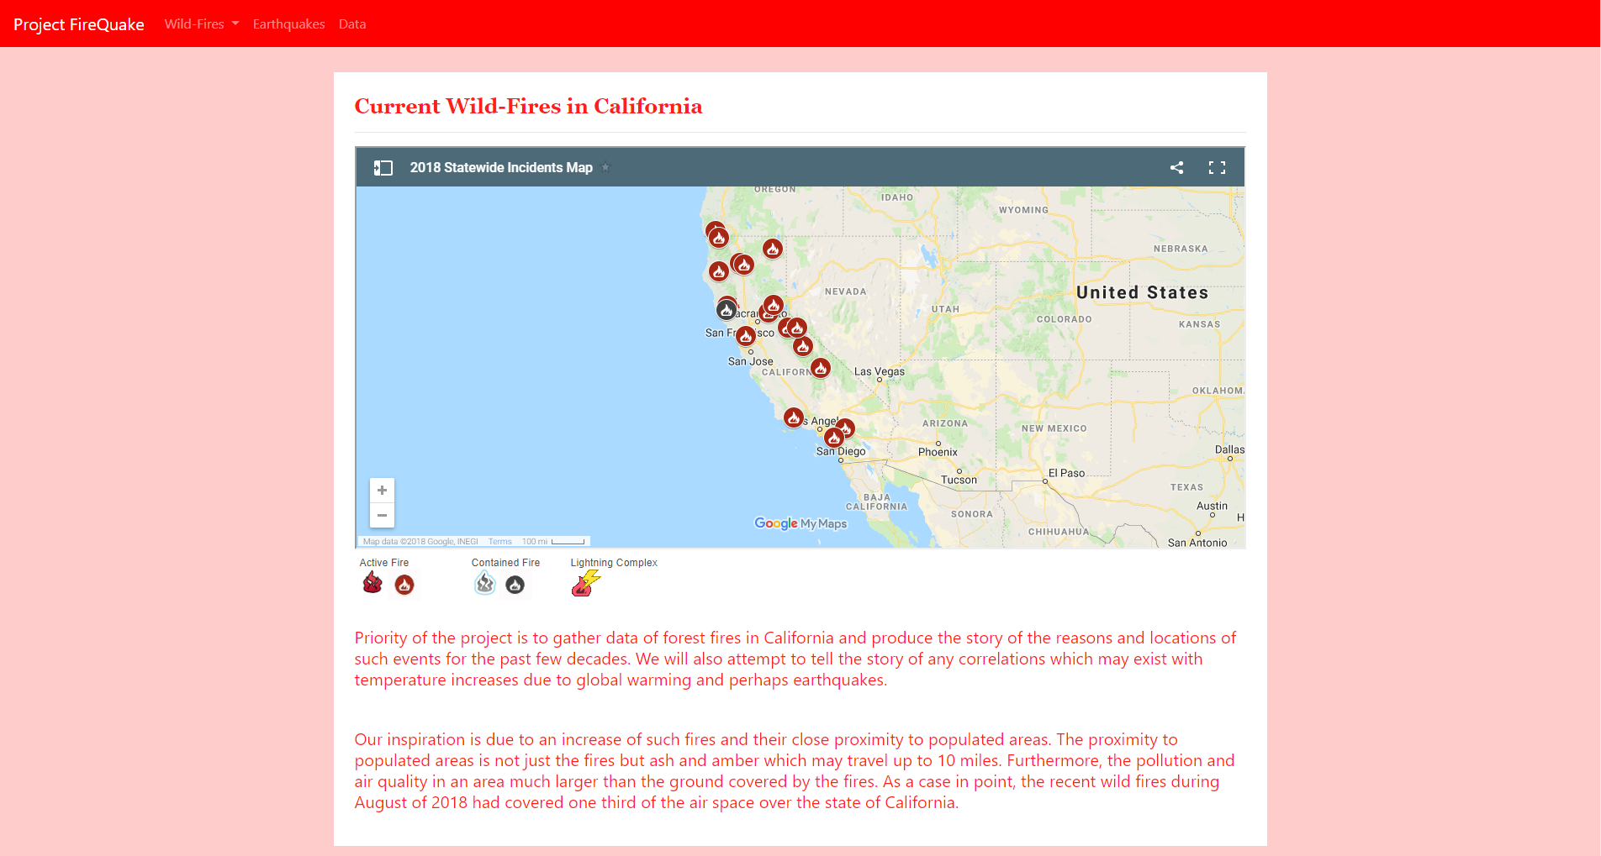
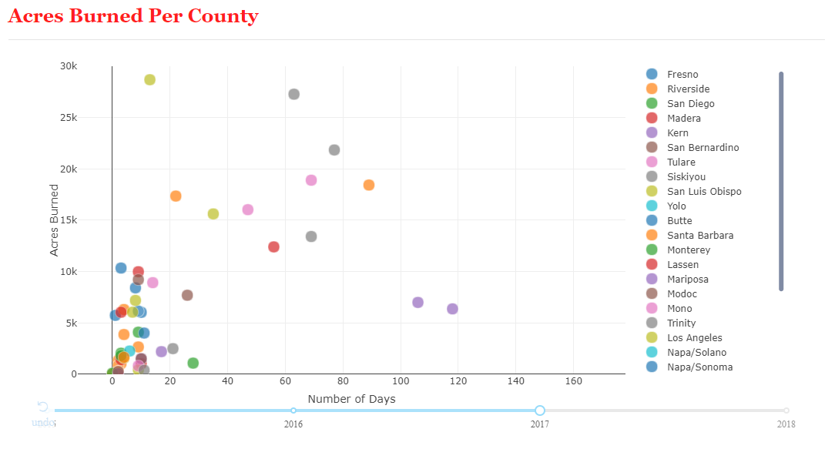
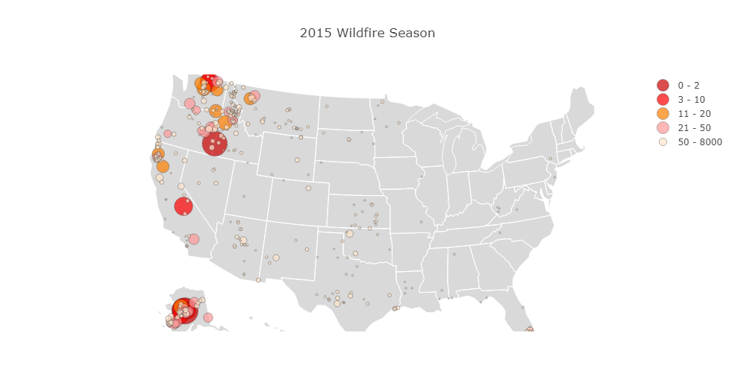
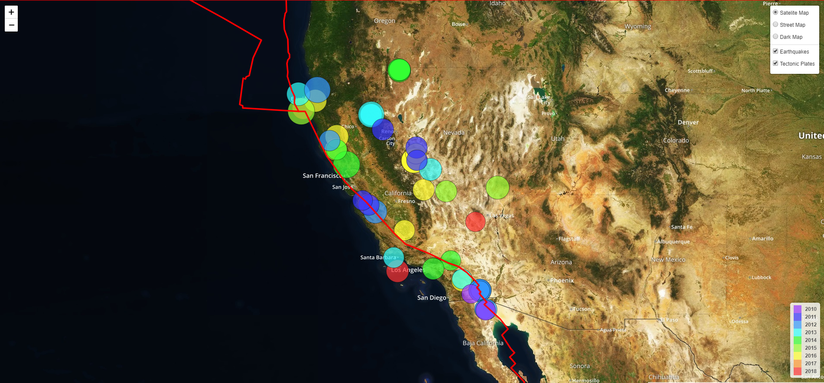
DATA VISUALIZATION

Slide 7


QUESTIONS?

